Slide 1

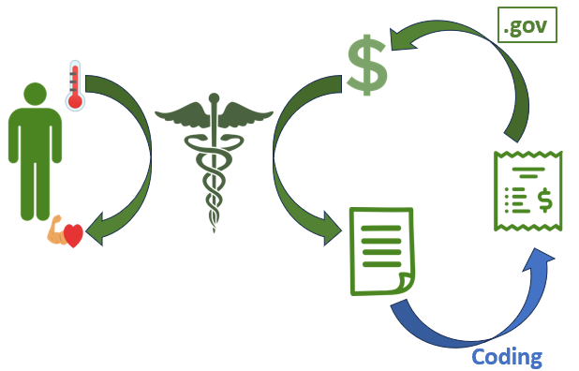
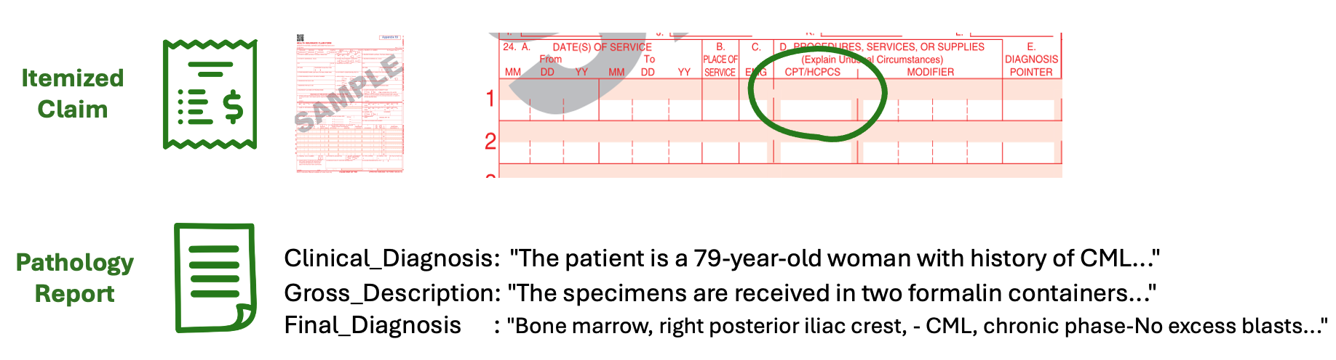
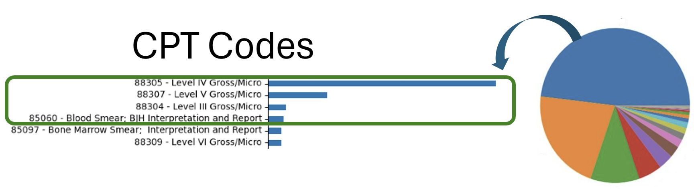
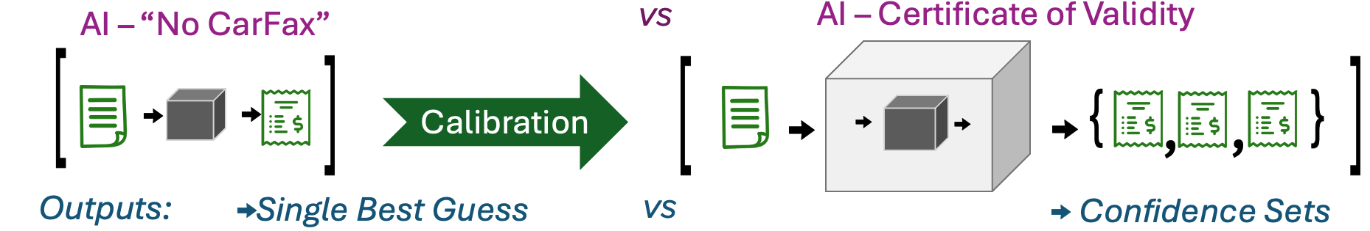
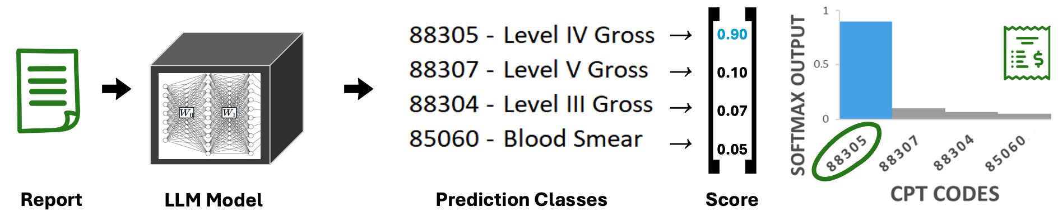
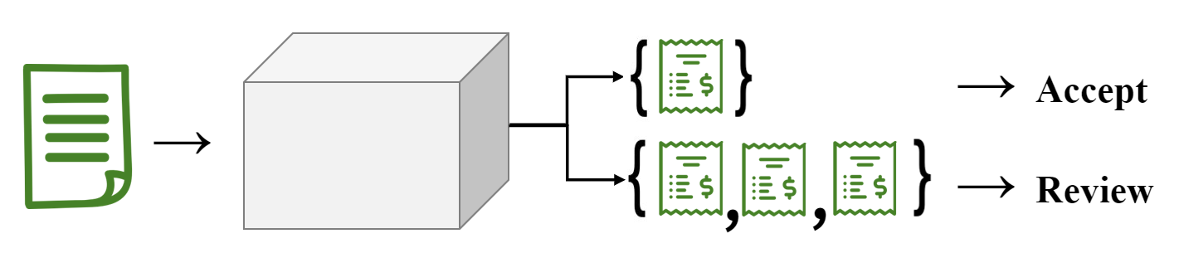

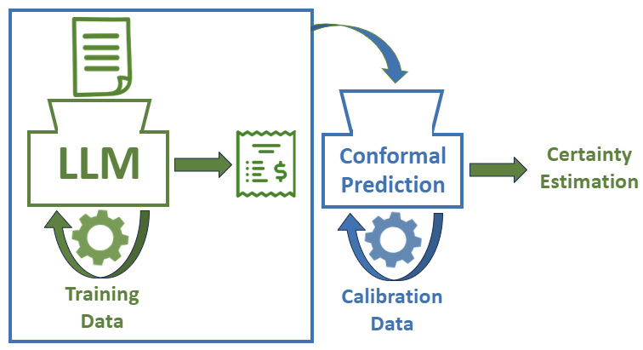
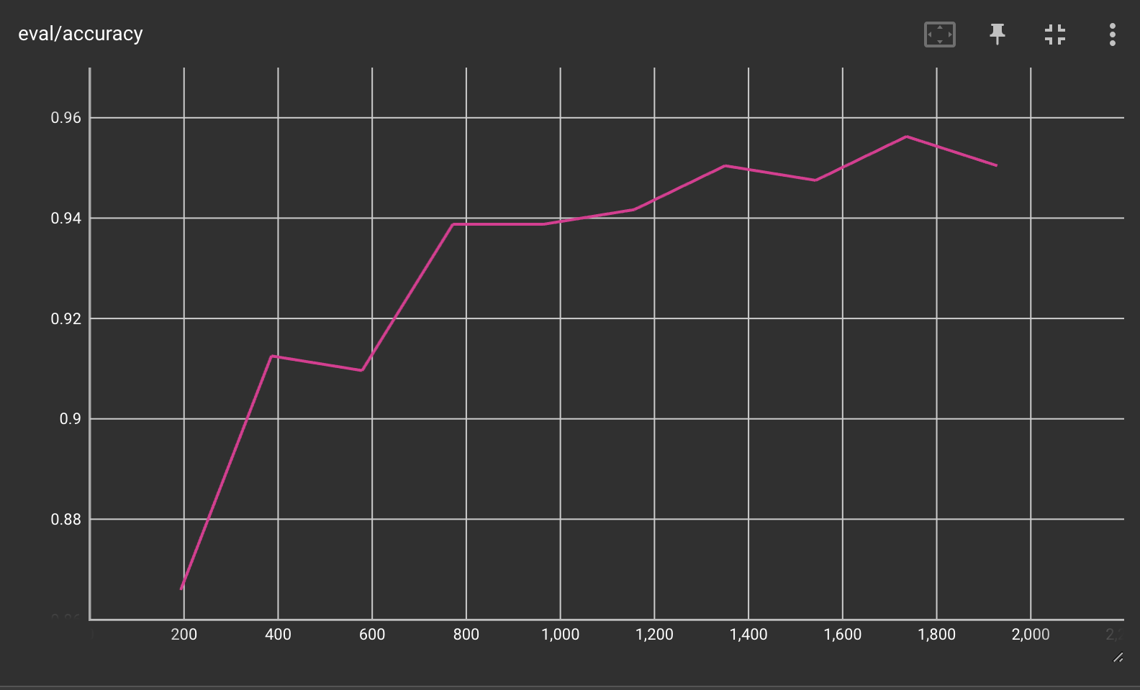

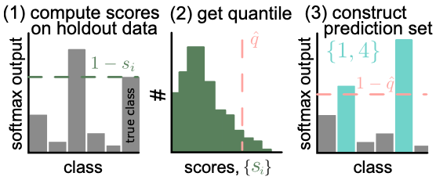
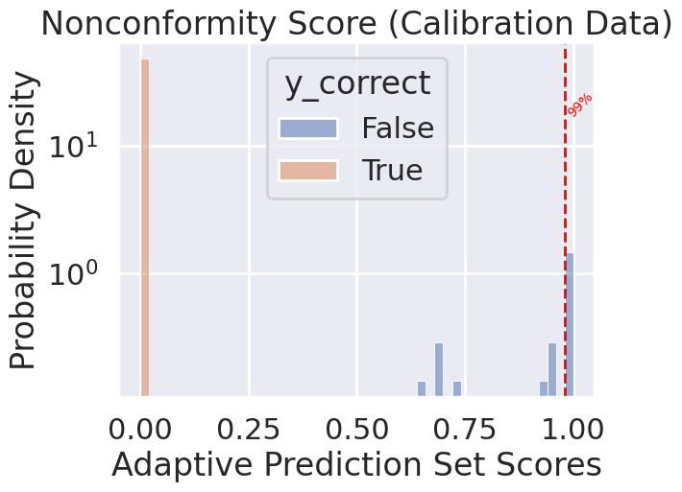
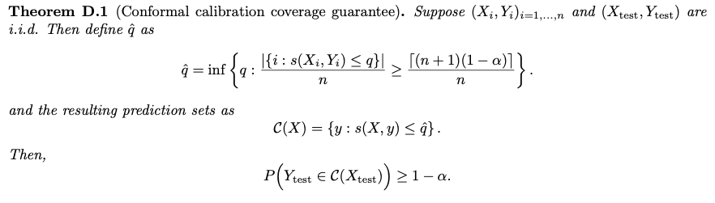
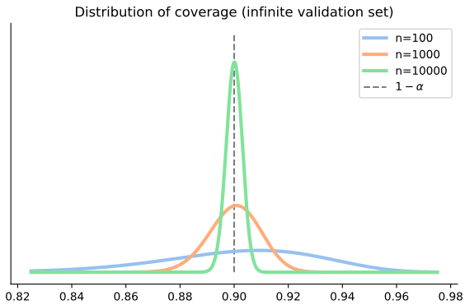
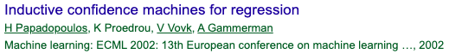
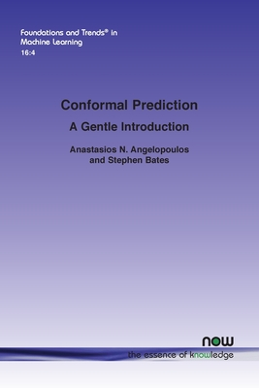
Conformal Prediction and Large Language Models for Medical Coding
x
Large Language Models (LLMs) promise efficiencies, but many applications are high-stakes, such as CPT procedure coding from Pathology reports.
We introduce a calibration procedure called “Conformal Prediction (CP)” that measures experimental uncertainty in the classification process.
We use holdout data to adapt a 95% accurate LLM CPT coder into a selective 99% accurate coder (without modifying any weights).
E
Christopher Snyder, MD PhD
Department of Pathology & Immunology
Washington University in St. Louis School of Medicine, St. Louis, MO
1
Large Language Models:
as Medical Coders^{[1]}
2
Big Picture of Conformal Prediction:
Creating statistically rigorous uncertainty sets.
A.
A.
Poor AI
Model Calibration
Honest AI
B.
B.
[Equation*]
C.
C.
3
Theory of Conformal Prediction
(*)
4
Putting it together: Conformal Coding with an LLM
A.
ML
Training Data
Training Data
Calibration Data
Test Data
Test Data
A.
B.
Model Calibration
C.
CP
Specified Validity 1 - ⍺ = 0.99
 | %
{IV} | 54.8
{V} | 19.2
{IV, III, V} | 11.3
{IV, V} | 5.5
{Smear, V} | 5.0
{III} | 2.6
B.
Fine Tuning LLM →
“Only” 95% Accuracy
C.
see reference [2]
Validity pdf
±δ
D.
Case Study 1
C(X) = { III, V } Text: “The specimens are received in two formalin filled…Gallbladder…Liver…”
Background: Liver biopsy specimens are coded 88307 – lvl V while galbladder is coded 88305 – lvl 3
Interpretation: Predictive uncertainty stems from conflicting evidence: in reality both codes apply
0.82
0.86
1-⍺
0.94
0.98
Case Study 2
C(X) = { III, IV } Text: “Specimen is… ‘Mitrofanoff stoma polyp’…”
Background: Coding for Nasal Polyp and GI Polyp is different
Interpretation: Predictive uncertainty stems from lack of information about site
Validity ⍺ + Confidence δ → n Samples
Abstract
Through fine tuning a language model on pathology report text alone, we can achieve 95% prediction accuracy of the top 5 most common CPT codes on our dataset. We also show the utility of conformal prediction, which allows us to raise our accuracy to 99.0% when we allow the model to abstain on making a prediction on 24% of the data. This is a value that is determined by a separate threshold on the scalar value of the predictor on the aforementioned validation set.
Allowing models to abstain allows differential automation of easy tasks.
LLMs with CP are a promising salve for the complexity of CPT coding.
No threshold effect of AI performance on AI utility in applications
[1] Ali Soroush et al. Large Language Models are Poor Medical Coders. NEJM 2024.
[2] Angelopoulos and Bates: Conformal Prediction – A Gentle Introduction. 2023.
Notes:
-Dimensions - The ideal size would be 48” W x 36” H, or 60” W x 48" H, allowing for some blank board space around the perimeter.
Graphical Abstract
Green = context, blue = that step
1. Person with thermometer (sick) and becomes helathy, squiggly (health care model, it is the enzyme), money (cofactor), documentation is produced…..in order to get money to keep going, you have to provide an itemized bill via medical coding
2. This picture is zoomed in of “coding” above….. “Sausage maker” LLM churn – Gear is below (mechanism of training and settings (i.e. parameters for the model), rectangle is data you train on) – bill
3. Model produces an output, and we want to be more cetain of its veracity
-----this blue is now a certainty estimation, a model’s model – it learns behavior of what it is
-----trains on a new data set, not the data set from before (i.e. calibration data)
-----on/off = if calibration data model says that the green model is certain, we leave it on and we can make a conformal prediction = certainty estimation = calibration → produces robustness

Slide 3

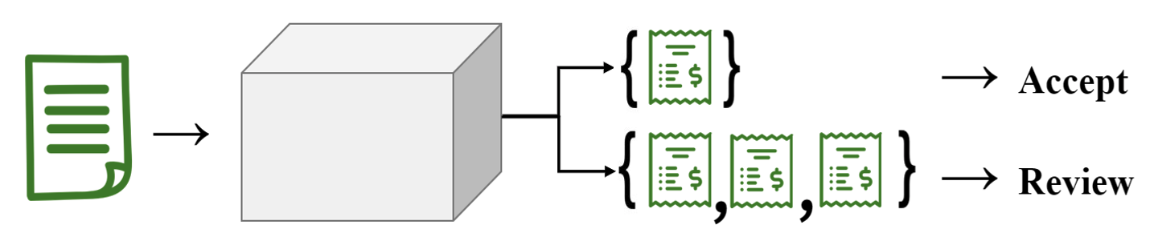
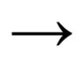
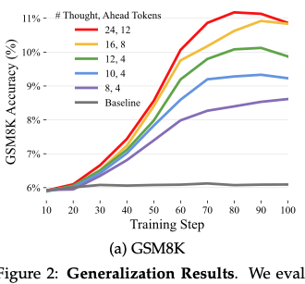
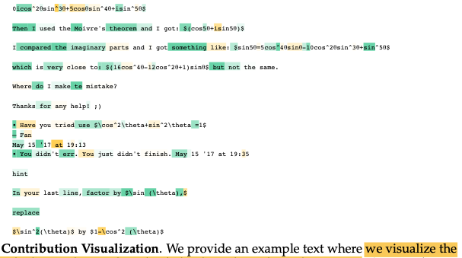
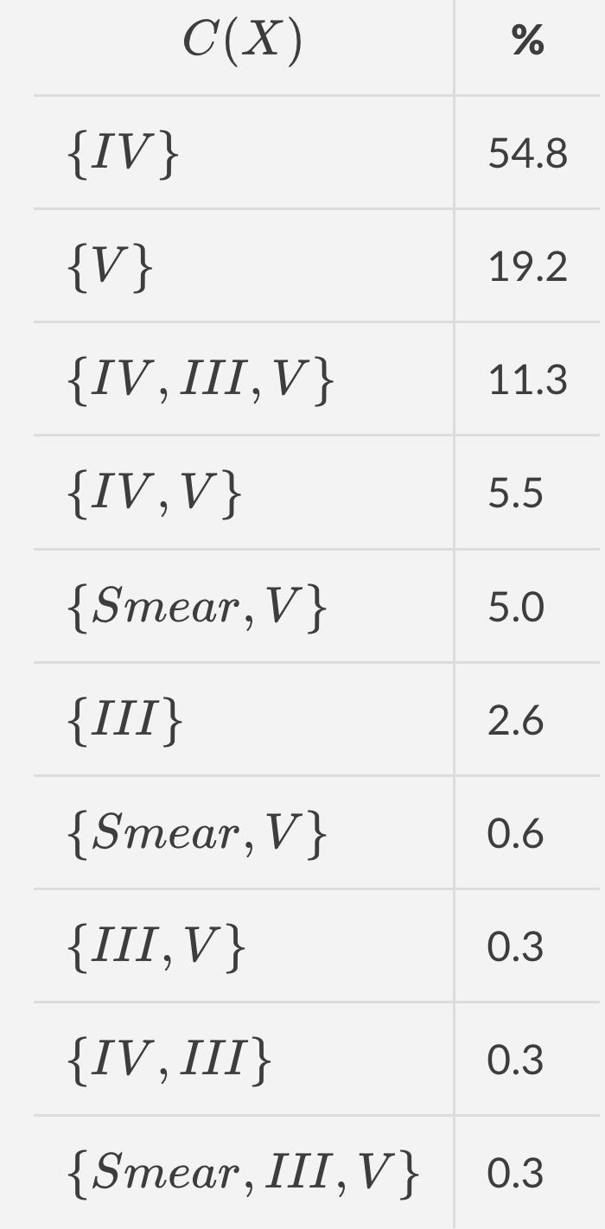
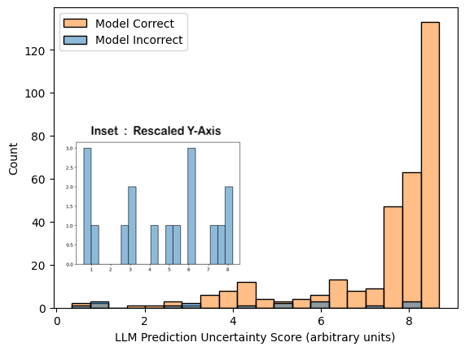
Figures – backups
Requirements:
-Dimensions - The ideal size would be 48” W x 36” H, or 60” W x 48" H, allowing for some blank board space around the perimeter.
23%
Score Function
s_{LLM}( X, Ypred, Ytrue)
Quantifies how misleading the model was

Slide 4
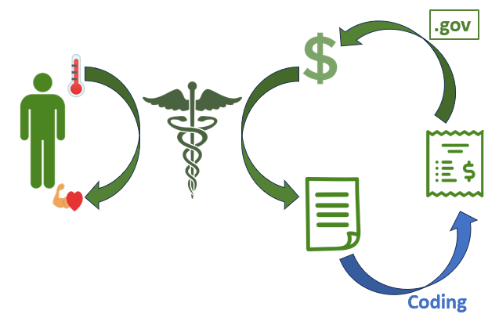
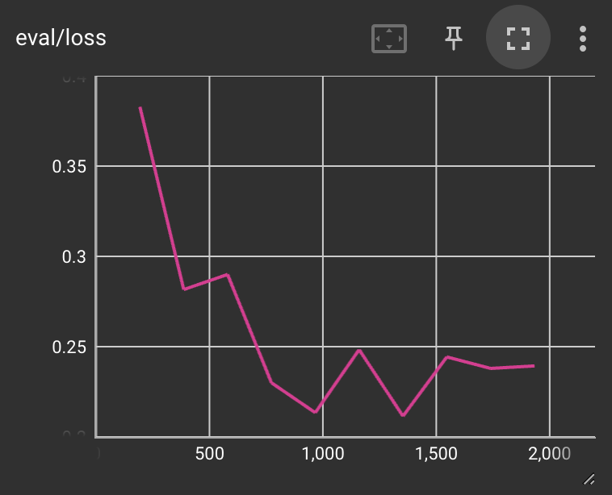
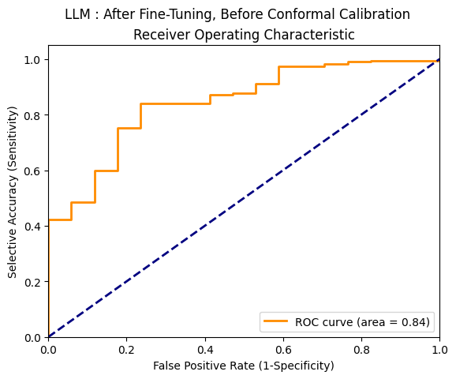
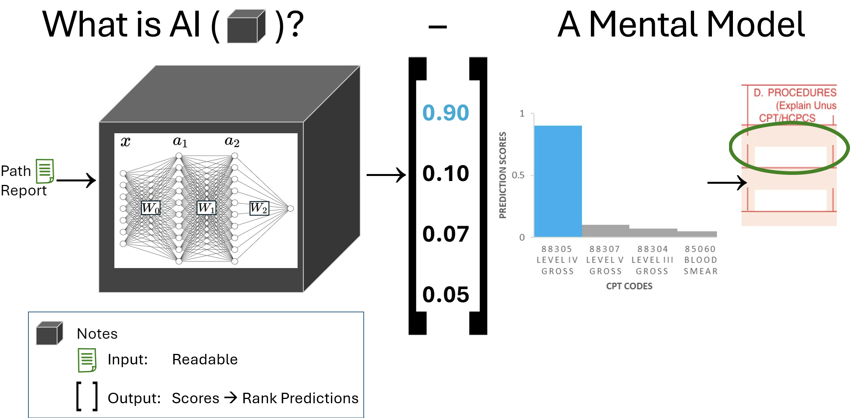
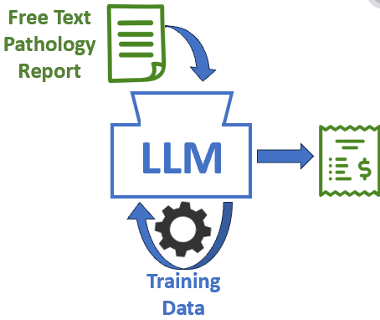
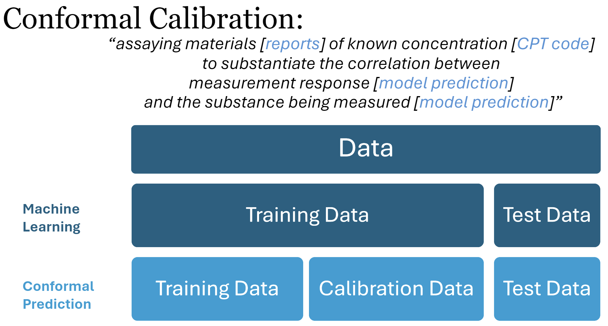
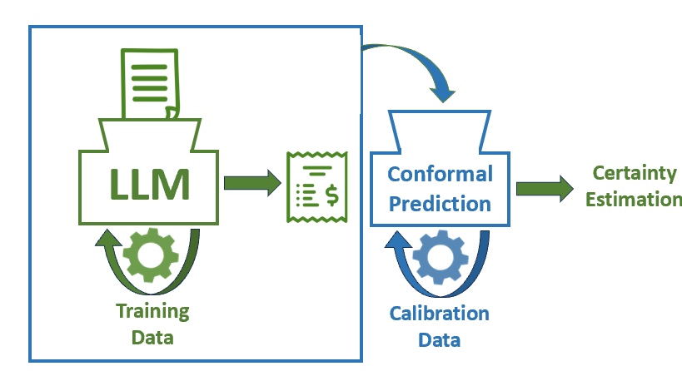
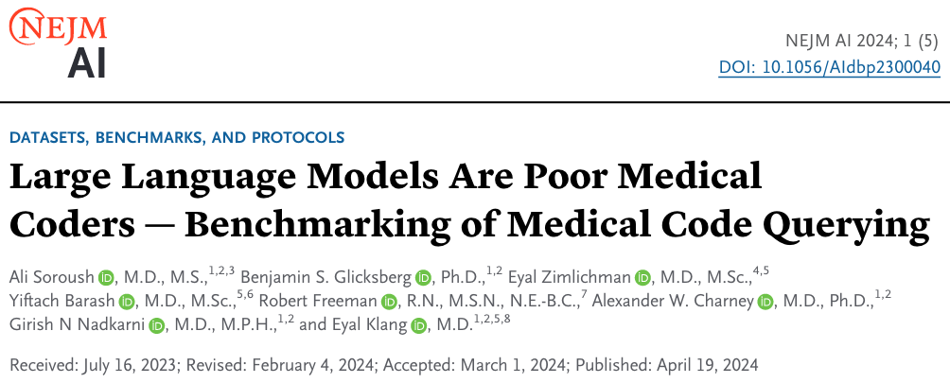
Conformal Prediction and Large Language Model for Medical Coding
For the top 5 most common CPT codes in our dataset, 95% prediction accuracy achieved for LLM trained to interpret pathology text reports.
99.5% prediction accuracy achieved with utility of conformal prediction.
Highlight #3
How to implement LLM with rock solid statistical guarantees
Iterative Process: 1. train a model to predict a desired output 2. characterize uncertainty in that first model prediction by using a second model (much simpler) and a second set of data. Like Calibrating for Accuracy then Validating Precision in a lab assay “Set it and forget it”
Our statistical guarantees means that one can apply LLM models to pretty much any problem or field, regardless of how sensitive or risk adverse the domain
<INSERT Take Home Message>
Christopher Snyder, MD PhD
Department of Pathology & Immunology
Washington University in St. Louis School of Medicine, St. Louis, MO
1
2
Figure 2 Main Message: “Beyond Sensitivity and Specificity”: Per-Sample Uncertainty
Figure 1 Main Message
[1, 0, 0, 0] 188
[0, 0, 0, 1] 66
[1, 0, 1, 1] 39
[1, 0, 0, 1] 19
[1, 1, 0, 1] 17
[1, 1, 1, 0] 9
TODO:
Per-Sample uncertainty estimation
TODO:
Cartoon of model and data setup
TODO:
More cartoons explaining coverage
TODO:
Thow in some stuff from Folder: “reports and meetings”
TODO:
I thnk I did this diagram wrong I put in score_fn? maybe instad of y_prob
TODO:
Readout of model training process
TODO:
Analogy with lab tests to exlpain how this is differrent thantrasining
3
4
TODO:
More cartoons explaining coverage
Figure 3 Main Message
Figure 4 Main Message
How to implement LLM with rock solid statistical gaurantees
Iterative Process: 1. train a model to predict a desired output 2. characterize uncertainty in that first model prediction by using a second model (much simpler) and a second set of data. Like Calibrating for Accuracy then Validating Precision in a lab assay “Set it and forget it”
Our statistical guarantees means that one can apply LLM models to pretty much any problem or field, regardless of how sensitive or risk adverse the domain
QR Code Place Holder
TODO:
LLM Application of Uncertainty Score function
QR Code Place Holder
TODO:
Data from witholding estimation
Abstract
Through fine tuning a language model on pathology report text alone, we can achieve 95% prediction accuracy of the top 5 most common CPT codes on our dataset. We also show the utility of conformal prediction, which allows us to raise our accuracy to 99.5% when we allow the model to abstain on making a prediction on 30% of the data. This is a value that is determined by a separate threshold on the scalar value of the predictor on the aforementioned validation set.
TODO:
Coverage results from top-k set prediction
References
Funding
Acknowledgements
Notes:
-Dimensions - The ideal size would be 48” W x 36” H, or 60” W x 48" H, allowing for some blank board space around the perimeter.
Graphical Abstract
Green = context, blue = that step
1. Person with thermometer (sick) and becomes helathy, squiggly (health care model, it is the enzyme), money (cofactor), documentation is produced…..in order to get money to keep going, you have to provide an itemized bill via medical coding
2. This picture is zoomed in of “coding” above….. “Sausage maker” LLM churn – Gear is below (mechanism of training and settings (i.e. parameters for the model), rectangle is data you train on) – bill
3. Model produces an output, and we want to be more cetain of its veracity
-----this blue is now a certainty estimation, a model’s model – it learns behavior of what it is
-----trains on a new data set, not the data set from before (i.e. calibration data)
-----on/off = if calibration data model says that the green model is certain, we leave it on and we can make a conformal prediction = certainty estimation = calibration → produces robustness

Slide 5
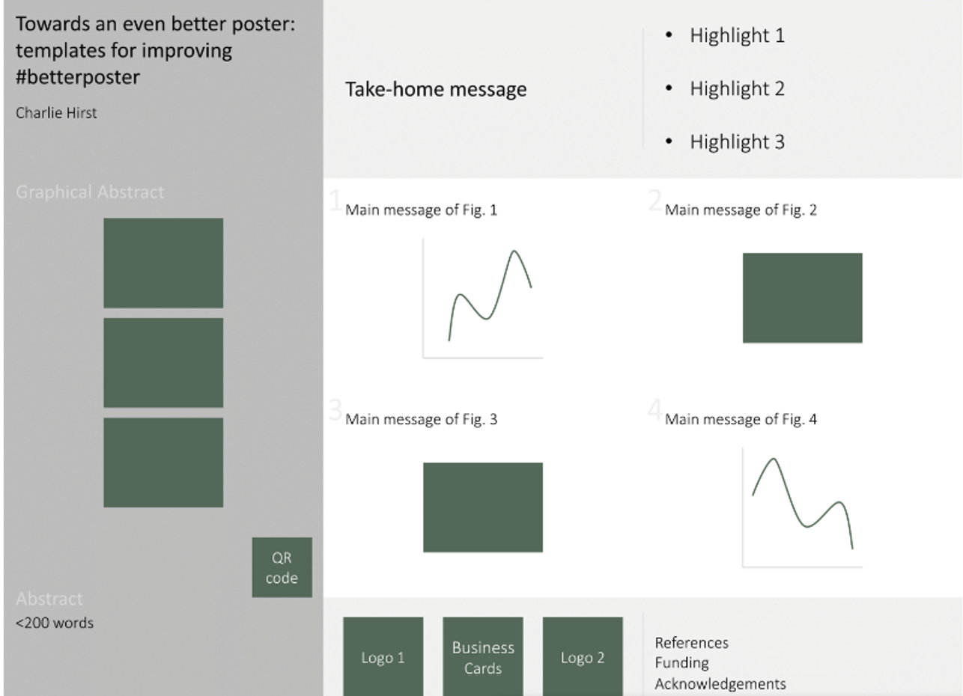

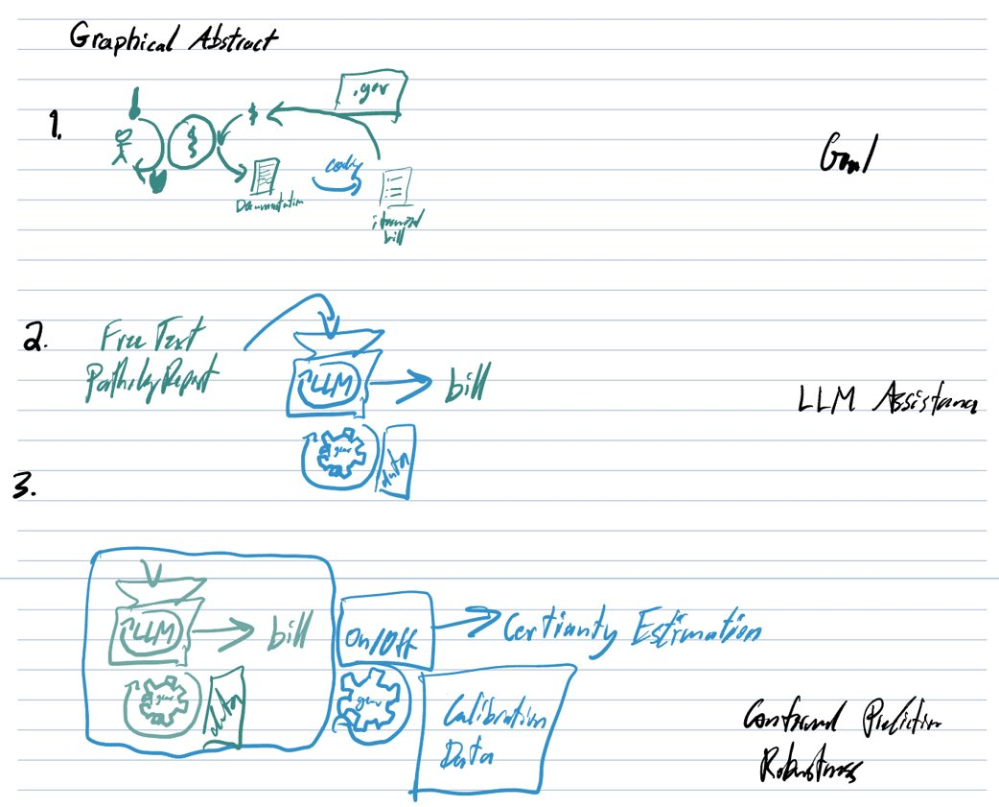
Notes:
-Dimensions - The ideal size would be 48” W x 36” H, or 60” W x 48" H, allowing for some blank board space around the perimeter.

Slide 7
Full Abstract
Background: In the United States, Medicare expenses are reimbursed through current procedural terminology (CPT) codes, which delineate medical procedures into categories with defined reimbursement rates. However, the assignment of procedure categories to medical events is a highly cumbersome logistical challenge for many healthcare organizations, and a significant contributor to medical expenses. Because of the complex nature of medical records, prior attempts at automation of procedure terminologies are just now developing with the advent of machine learning methods.
Methods: We developed a high reliability final predictor of CPT codes on a subset of pathology procedures using a fine-tuned large language model (LLaMA-3B, Meta AI, New York, New York, USA) adapted with conformal prediction. As input, we use 2018 pathology report text data, including gross report, microscopic description, brief medical history, and final diagnosis. We define our dataset with the top five most common technical component CPT codes, which account for 85% of all samples. As a predictor of the veracity of the large language model prediction, we use the scalar value output of the classification model itself, as is common in conformal prediction. The validation set (separate from the testing set) is used to set a prediction threshold below which the model withholds judgement.
Results: We show that, by fine tuning an off-the-shelf language model on pathology report text alone, we can achieve 95% prediction accuracy of the top 5 most common CPT codes on our dataset. We also show the utility of conformal prediction, which allows us to raise our accuracy to 99.5% when we allow the model to abstain on making a prediction on 30% of the data. This is a value that is determined by a separate threshold on the scalar value of the predictor on the aforementioned validation set.
Conclusions: Large language models are a powerful tool for overcoming a challenging problem in medical billing. The combination of a highly flexible model like large language models, paired with a method of data-driven domains of model reliability afforded by conformal prediction can prove to be an invaluable tool in improving healthcare efficiency and reducing medical costs.

Slide 8

Alternative color palattes below

Slide 9










Conformal Prediction and Large Language Model for
Medical Coding
Take Home Message
Highlight 1
Highlight 2
Highlight 3
Christopher Snyder, MD PhD
.gov
Free Text Pathology Report
LLM
Coding
Training
Data
Free Text Pathology Report
LLM
LLM
Conformal
Prediction
Certainty Estimation
QR Code Place Holder
Training
Data
Training
Data
Calibration
Data
Abstract
(<200 words)….would need to shorten original extract, pasted on slide 4
References
Funding
Acknowledgements
Notes:
-Dimensions - The ideal size would be 48” W x 36” H, or 60” W x 48" H, allowing for some blank board space around the perimeter.
Graphical Abstract
Green = context, blue = that step
1. Person with thermometer (sick) and becomes helathy, squiggly (health care model, it is the enzyme), money (cofactor), documentation is produced…..in order to get money to keep going, you have to provide an itemized bill via medical coding
2. This picture is zoomed in of “coding” above….. “Sausage maker” LLM churn – Gear is below (mechanism of training and settings (i.e. parameters for the model), rectangle is data you train on) – bill
3. Model produces an output, and we want to be more certain of its veracity
-----this blue is now a certainty estimation, a model’s model – it learns behavior of what it is
-----trains on a new data set, not the data set from before (i.e. calibration data)
-----on/off = if calibration data model says that the green model is certain, we leave it on and we can make a conformal prediction = certainty estimation = calibration → produces robustness

Slide 10
Conformal Prediction and Large Language Model for
Medical Coding
Take Home Message
Highlight 1
Highlight 2
Highlight 3
Christopher Snyder, MD PhD
.gov
Coding
LLM
Free Text Pathology Report
QR Code Place Holder
Data
Abstract
(<200 words)….would need to shorten original extract, pasted on slide 4
References
Funding
Acknowledgements
Notes:
-Dimensions - The ideal size would be 48” W x 36” H, or 60” W x 48" H, allowing for some blank board space around the perimeter.
Graphical Abstract
Green = context, blue = that step
1. Person with thermometer (sick) and becomes helathy, squiggly (health care model, it is the enzyme), money (cofactor), documentation is produced…..in order to get money to keep going, you have to provide an itemized bill via medical coding
2. This picture is zoomed in of “coding” above….. “Sausage maker” LLM churn – Gear is below (mechanism of training and settings (i.e. parameters for the model), rectangle is data you train on) – bill
3. Model produces an output, and we want to be more cetain of its veracity
-----this blue is now a certainty estimation, a model’s model – it learns behavior of what it is
-----trains on a new data set, not the data set from before (i.e. calibration data)
-----on/off = if calibration data model says that the green model is certain, we leave it on and we can make a conformal prediction = certainty estimation = calibration → produces robustness

